Slide 1
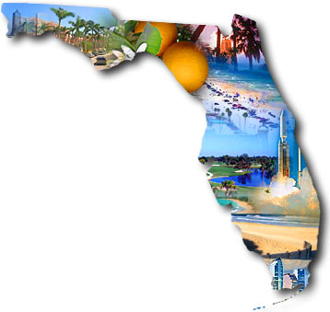
The Amazing Land of Florida!
SC.6.E.6.2
Florida Picture. http://www.capecoral.net/entrepreneur_guide/licenses_and_permits.php
©Copyright 2014- all rights reserved www.cpalms.org

Slide 2
Learning Goal
Students will be able to recognize a variety of different landforms on the Earth’s surface and relate these landforms as they apply to Florida. SC.6.E.6.2
©Copyright 2014- all rights reserved www.cpalms.org

Slide 3
Essential Questions (Keep these questions in mind as we complete activity)
What kinds of landforms are found on the Earth’s surface?
2. Of the landforms listed in question 1, which ones are found in Florida?
3. How has erosion and deposition shaped the landforms found in Florida?
©Copyright 2014- all rights reserved www.cpalms.org

Slide 4
Landforms Vocab Review
Erosion
Deposition
Wind erosion
Wave erosion
Glacial erosion
Water erosion
Delta
Peninsula
©Copyright 2014- all rights reserved www.cpalms.org

Slide 5
Just in case you didn’t know…
Every place in the state of Florida is 110 kilometers or closer to water. About 25 million years ago, Florida was under water, and many of the state’s landforms are a result of the changing sea level.
©Copyright 2014- all rights reserved www.cpalms.org

Slide 6
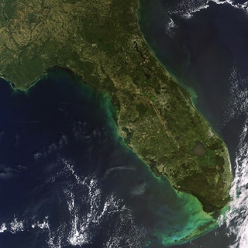
The Florida Peninsula
Florida sits on a huge limestone platform
Limestone is a sedimentary rock formed from the remains of tiny sea animals that hardened over time
Florida’s size and shape changed repeatedly as sea levels rose and fell.
Question: How many different landforms do you recognize from this picture?
Earth Snapshot. http://www.eosnap.com/lakes/everglades-and-lakes-on-the-florida-peninsula-usa/
©Copyright 2014- all rights reserved www.cpalms.org

Slide 7
What are the 3 Regions of Florida Landforms?
Northern Highlands- gently sloping plateaus
Central Highlands- long ridges
Coastal Lowlands- dunes, vast wetlands, southern end of peninsula, beaches (Atlantic and Gulf coasts)
Question: Which landform region is our school located?
Earth Snapshot. http://www.eosnap.com/lakes/everglades-and-lakes-on-the-florida-peninsula-usa/
©Copyright 2014- all rights reserved www.cpalms.org

Slide 8
About Florida’s Landforms
Over a million years, erosion and deposition have shaped Florida’s landscape and formed…
Rivers
Hills
Ridges
Coastal features
Lakes
Wetlands
©Copyright 2014- all rights reserved www.cpalms.org

Slide 9
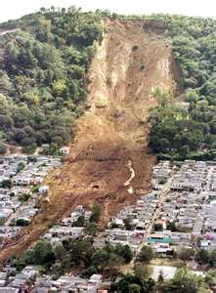
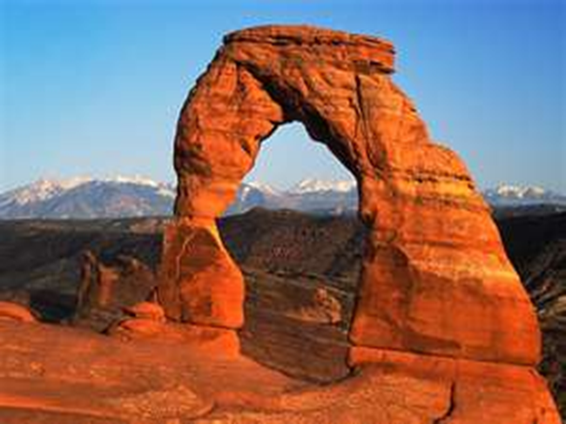
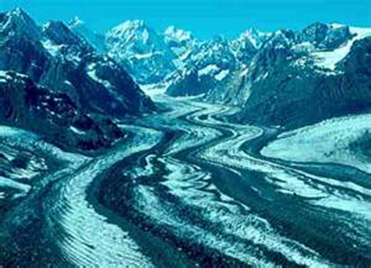
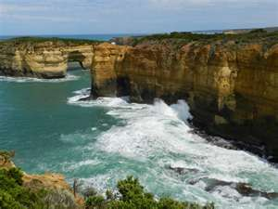
Erosion
Wind Erosion
the removal and transport of weathered and non-weathered material by gravity, running water, wind, waves, ice, and underground water.
Gravity
Glacial
Water

Slide 10
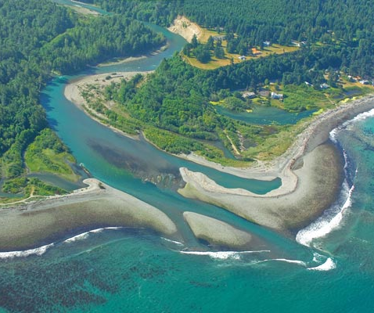
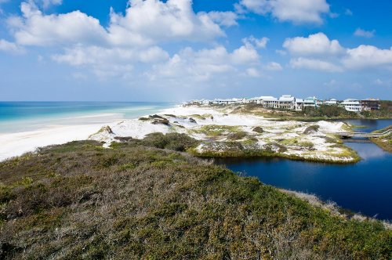
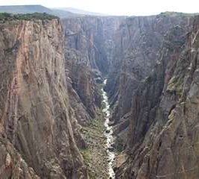
Deposition
Deposition is how sediment moves by erosion, is dropped, and comes to rest. HOW IT IS DEPOSITIED or PLACED This is how canyons and deltas are formed.

Slide 11
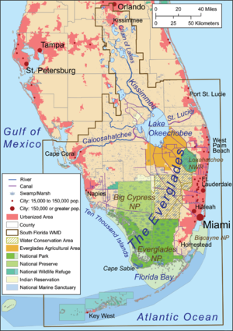
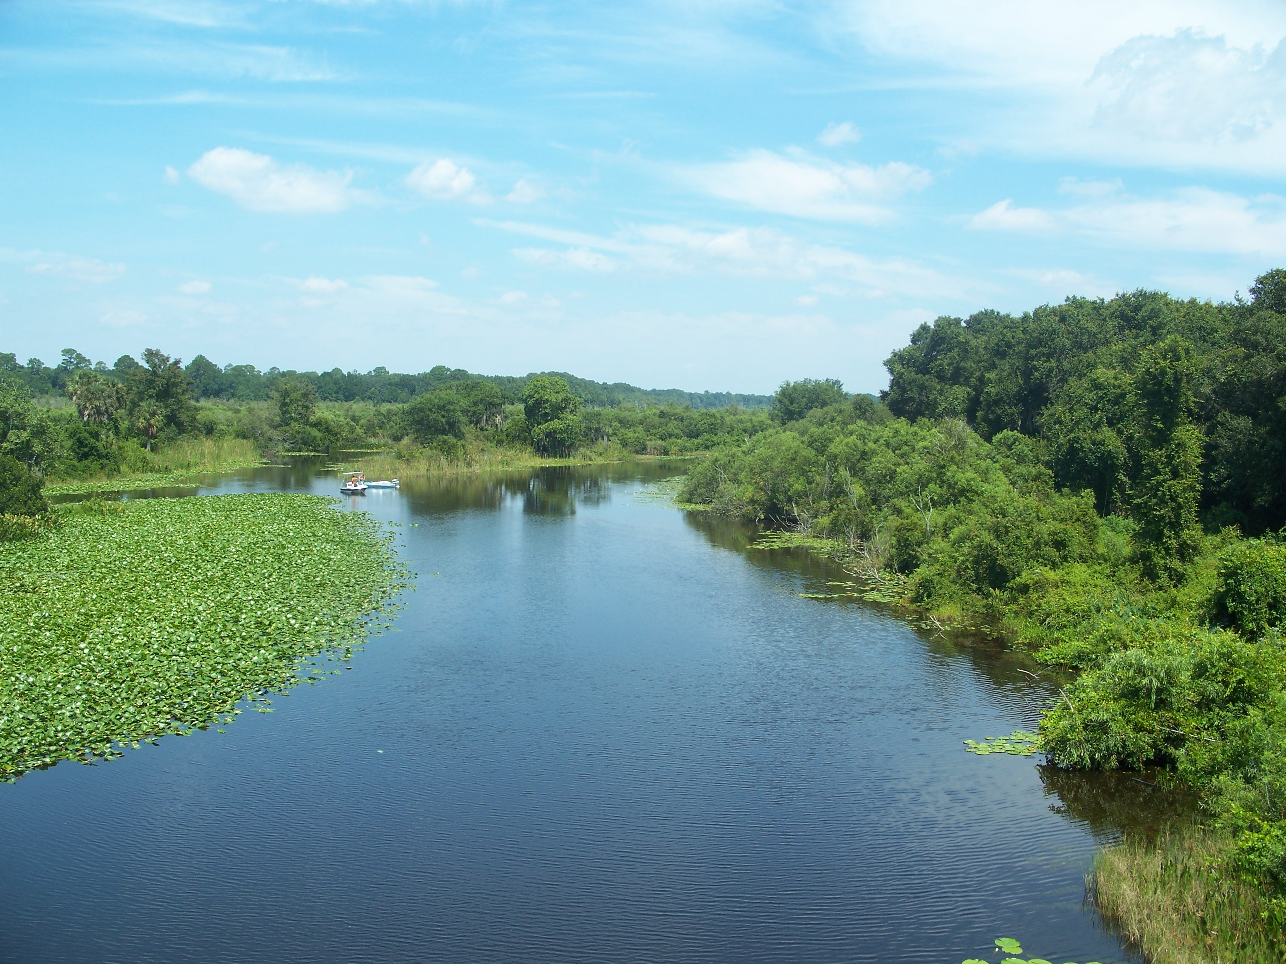
Rivers
Florida’s streams and rivers carry and drop (deposition) sediment along the coast, helping to form beaches, barriers islands, and deltas
Ocklawaha River. http://en.wikipedia.org/wiki/List_of_rivers_of_Florida
http://en.wikipedia.org/wiki/List_of_rivers_of_Florida
©Copyright 2014- all rights reserved www.cpalms.org

Slide 12
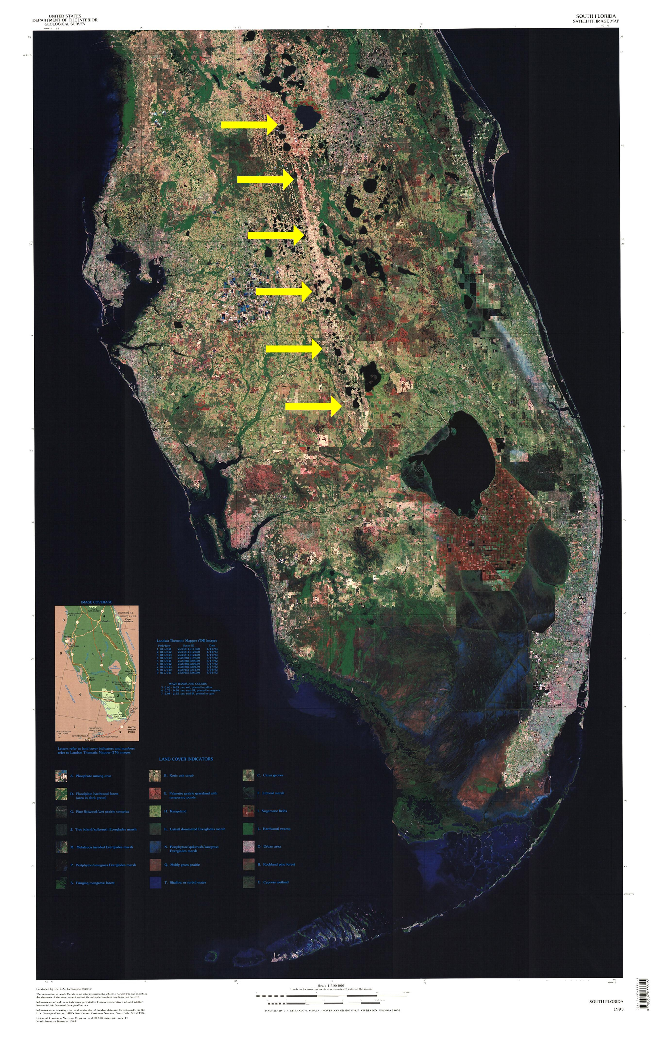
Ridges and Hills
Ridges
Run parallel to the coast
Mark ancient shorelines
Hills
Some in northern highlands are taller than Florida’s ridges
Lake Wales Ridge. http://en.wikipedia.org/wiki/Lake_Wales_Ridge
©Copyright 2014- all rights reserved www.cpalms.org

Slide 13
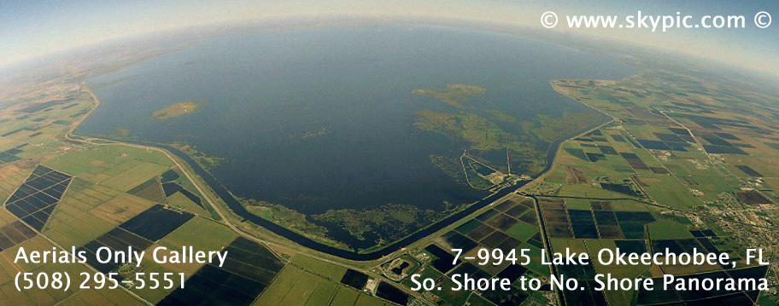
Lakes
Formed after erosion dissolved the limestone plateau beneath them
More than 7,000 lakes across Florida
Lake Ockeechobee
Geology.com. http://geology.com/satellite/florida-satellite-image.shtml
Joseph R. Melanson. http://www.skypic.com/flcentral.htm
©Copyright 2014- all rights reserved www.cpalms.org

Slide 14
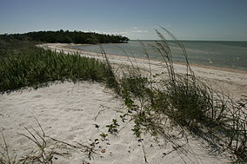
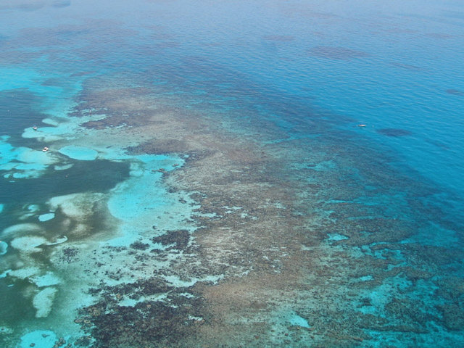
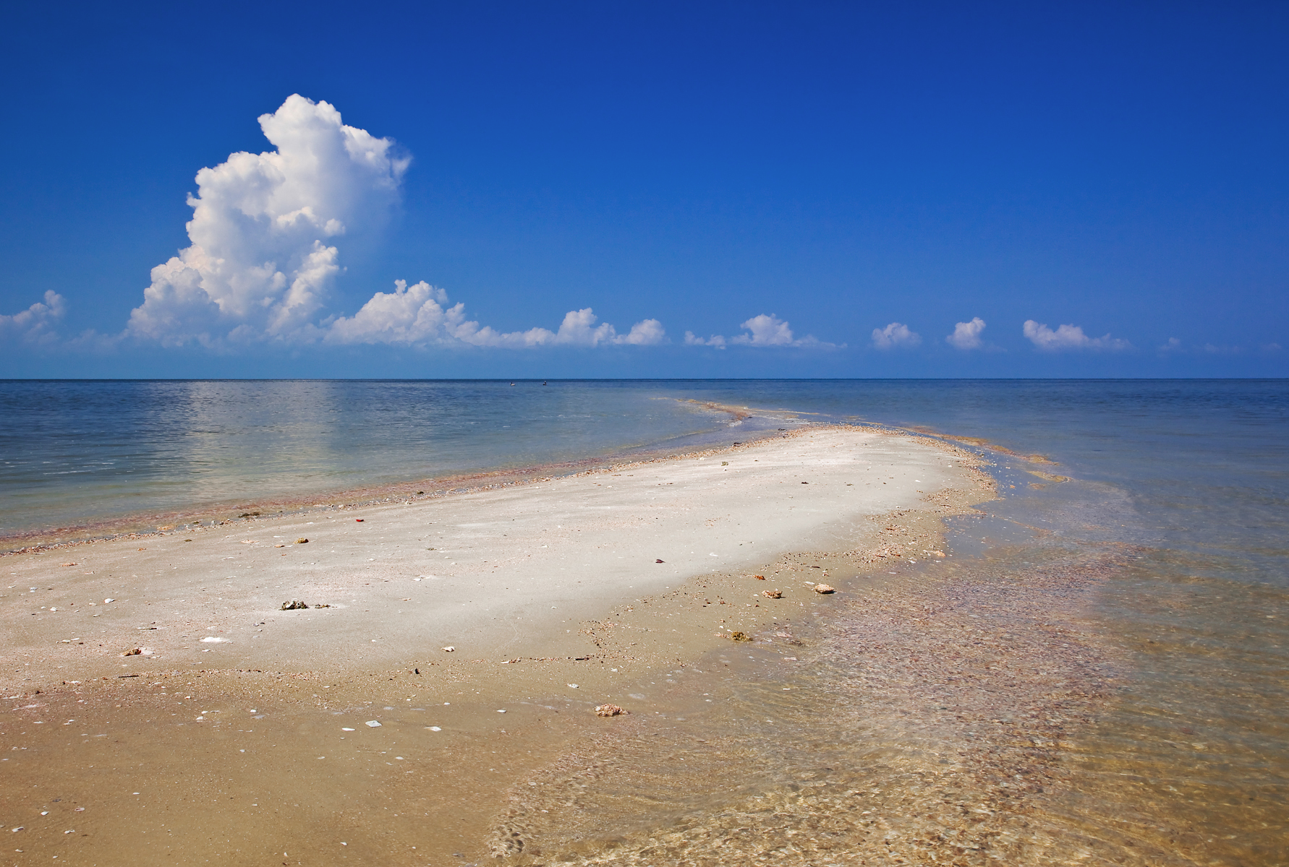
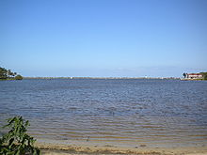
Coastal Features
Waves and currents shaped Florida’s coastline forming bays, sandbars, and barrier islands
Florida beaches consist of coral from offshore reefs and other materials including shell fragments. Barrier reefs are formed offshore by coral colonies.
Beach Shoreline
Offshore reefs
Sandbar
Bay
Ten Thousand Islands Beach shoreline and vegetation. http://en.wikipedia.org/wiki/Ten_Thousand_Islands
Carysfort Reef off of Key Largo. NOAA. http://blog.al.com/live/2010/05/scientists_fear_oil_spill_will.html
http://www.floridarambler.com/florida-canoeing-kayaking-paddling/everglades-city-kayak-10000-islands/
Palm Bay. http://en.wikipedia.org/wiki/Palm_Bay_(Florida)
©Copyright 2014- all rights reserved www.cpalms.org

Slide 15
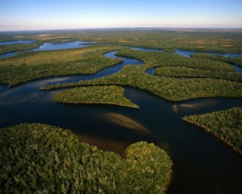
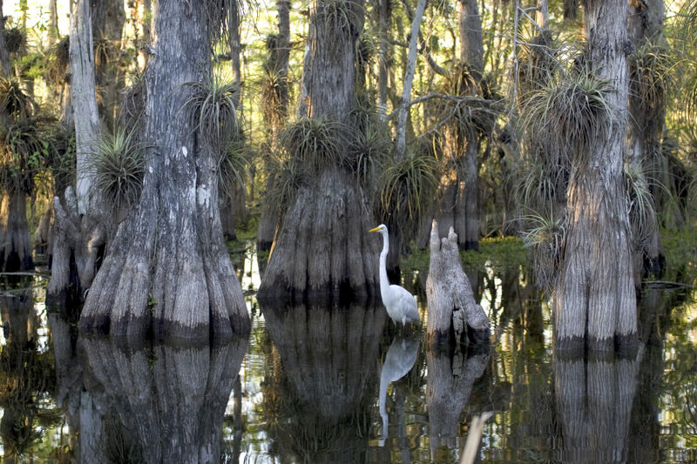
Wetlands
http://www.seathos.org/tag/florida-everglades/
Everglades is a large wetland that covers several thousand square kilometers
The Everglades formed on a flat block of limestone that tilts gently toward the south
Shallow layer of water flows from Lake Okeechobee across the Everglades to Florida Bay
http://www.globaltrekkers.com/Everglades.html
©Copyright 2014- all rights reserved www.cpalms.org

Slide 16
Florida’s Amazing Land Practice! (Activity #1)
Now it is time to test your knowledge. Put your notes away and clear your desk.
Look at the cards provided to you. With your partner, match the landforms types with the descriptions, examples, and landform regions. Your cards should look like this:
When you are complete, raise your hand so I can review your work.
Landform | Description | Picture example | Landform Regions
©Copyright 2014- all rights reserved www.cpalms.org

Slide 17
Florida Landscapes (Activity #2)
Next, you and partner will use modeling clay to design a landscape that I assign to your group.
Use the provided blank map of Florida and modeling clay to model the selected landform.
When the landform model is complete, write an explanation of your modeled landform that explains where the landform can be found in Florida and how it was formed.
When complete, raise your hand so your work can be reviewed by your peers.
©Copyright 2014- all rights reserved www.cpalms.org

